Slide 1
CISC/CMPE 332 W26
Database Management Systems
Instructions created by: Dr. Wendy Powley
Modified by: Kazi Amit Hasan

Slide 2

Team (Instructor)
Kazi Amit Hasan
Research area: Agentic AI, Software Engineering, Software Security, LLM, MSR
My Journey:
2020: Bachelor in Computer Science
2020-2022: Machine Learning Engineer, ACI Limited, Bangladesh
2022: Joined Queen’s as MSc Student
2023: Promoted to PhD without MSc completion
2026: Joined Queen’s a Teaching Fellow
Others:
Advising as Data Analyst in two departments in Queen’s

Slide 3
Team (Teaching Assistants)
Emails can be found on the classlist page (Communications >> ClassList).
Yuanqi Liang
Ashfi Shah
Mohammed Mehedi Hasan
Marcus Secord
Abdul Moez Akbar
Jasmine Zangeneh
Liam Johnston
TBD
TBD

Slide 4
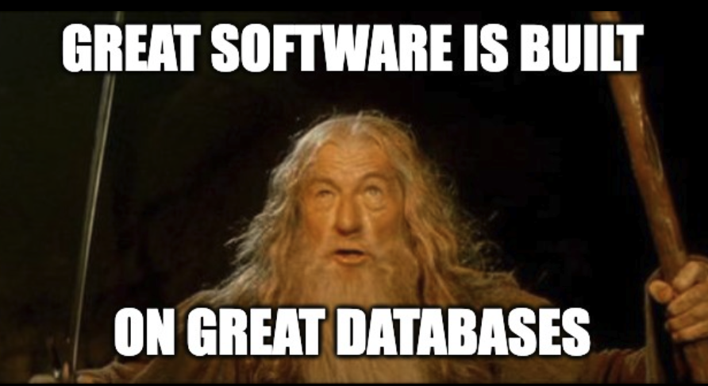
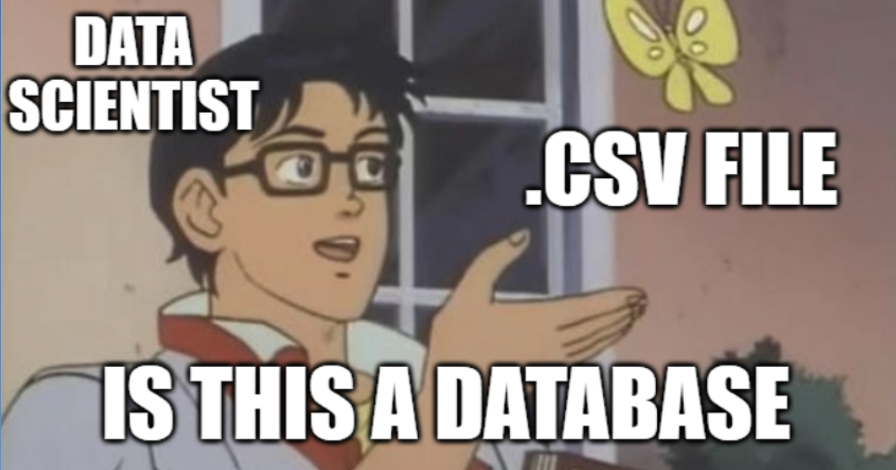
Why you need this course?
Software development
Data Science domain
Design a twitter feed
You can't just load a 500GB dataset into a Pandas DataFrame in memory.
Notes:
'Design a Twitter feed.' They aren't asking about the CSS. They are asking: 'How do you model the database to read millions of tweets efficiently?

Slide 5
Course Contents
Intro to data/databases
Entity-Relationship Modeling
Relational Model
SQL: Data Definition Language
Relational Algebra
Database Web Applications/Application Programming
Indexes & Storage
Security
and some special content by our head TA! (to be decided)

Slide 6
OnQ
All course materials
All correspondence, class discussions, interaction with TAs/Instructor done via ONQ
All projects/assignments submitted & marked on ONQ

Slide 7
Course Format
Fully in-person – 3 lectures per week (usually)
lectures will NOT be recorded
Content->Weekly Schedule
ONQ page for each week

Slide 8
Course Materials
Lecture slides (if used) will be posted but not all lectures use slides!
Textbook – Database System Concepts, Silberschatz, Korth, Sudarshan 6th Edition.
Best way to learn the material is come to class, do the assignments.
If I find any materials helpful, I will post that on OnQ.
Whole internet

Slide 9
Project (Assignments)
Consists of 3 parts:
planning (Entity relationship diagram)
implementation (relational implementation)
application program (including demo)
You will learn some basics of web development (very basic)
please just use these basics even if you have more experience.
You must have some programming background!

Slide 10
Assignments
Two additional assignments will be posted:
relational algebra & SQL
These are ungraded but can be handed in for feedback.
Highly recommended that you do them since they cover material that you will find on the midterm quiz and final exam

Slide 11
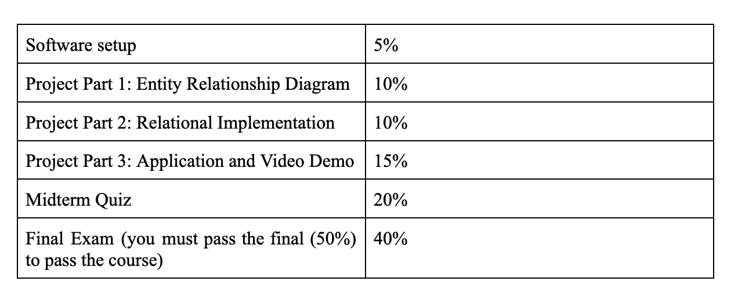
Marking Scheme

Slide 12
Midterm Quiz and Final Exam
Midterm quiz (in person): TBD (I will post in OnQ once I finalize the date and time)
If you are ill, you must apply for considerations BEFORE the midterm time.
You must not attend the quiz if you apply for consideration.
Considerations will not be granted if I receive application after the midterm quiz time.
Considerations are only available for illness and unavoidable cases.
Accommodated tests/exams – handled via Ventus

Slide 13
Mid term Quiz
There will be NO make-up midterm.
If you successfully apply for considerations, your midterm marks will be shifted to the final exam (making the final worth 60%).

Slide 14
Deliverables
All due dates are posted on the Course Calendar now.
All assignments will be accepted up to 24 hours after the deadline without penalty. No further extensions will be granted without application for considerations or accommodations.
Assignments late by 1 second are NOT ACCEPTED.

Slide 15
Getting help
Discussion boards
Email a TA
Email to Instructor – please use sparingly!
Office hours (week 2 and beyond):
Instruction office hour: TBD (will be posted in OnQ)
TA office hours: TBD (will be posted in OnQ)

Slide 16
Assignment remarking policy
If you feel that there’s error in the marking of your assignment, you must request a remark within the window of opportunity.
Window of opportunity: it begins 24 hours after the ‘grades posted’ emails are out. From that, you have 72 hours to request a remark.
Example: If grades are announced on Monday at 12.00 noon, you may send a request for remarking from Tuesday 12.00 noon to Friday 12.00 of the same week.
Requests outside of this window will be ignored
Where to email?
Check the initials in your assignment feedback. Send a detailed email to the TA (keep me in cc)

Slide 17
Use of GenAI tools
Allowed only for learning and understanding concepts.
Do not use them:
For assignments
For Quiz

Slide 18
Computing Resources
Web server solution stack package - XAMPP
https://www.apachefriends.org/download.html
XAMPP includes MySQL (MariaDB)
First assignment is to get this installed and running. You can start on that now! 5%

Slide 19
Questions?

